Slide 1


Peter Allain
October 2025
SpaceX Falcon 9 Launch Analysis with Data Science

Slide 2

Introduction
SpaceX Falcon 9 is a reusable rocket that reduces launch costs.
Predicting the success of landings is important for cost efficiency.
This project uses Data Science techniques to analyze launch data.
Goal: Build a model to predict whether Falcon 9 first stage will land successfully.

Slide 3
Data
Source: SpaceX launch records (public dataset & API)
Timeframe: 2010 – recent launches
~100+ Falcon 9 missions analyzed
Key features: launch site, payload mass, orbit, booster landing outcome

Slide 4

Section 1

Slide 5
Methodology
• Data collection: SpaceX API & public dataset (CSV)
• Data wrangling: Removed duplicates, handled missing values, standardized units
• Exploratory Data Analysis (EDA): Visualizations and SQL queries to find patterns
• Interactive visual analytics: Built with Folium maps & Plotly Dash dashboards
• Predictive analysis: Applied classification models (Logistic Regression, Decision Tree) and evaluated performance

Slide 6
Data Collection
• Collected data from SpaceX API and public dataset (CSV)
• Timeframe: 2010 – most recent Falcon 9 launches
• ~100+ missions analyzed
• Cleaned dataset: removed duplicates, handled missing values, standardized fields

Slide 7
EDA
• Analyzed launch site frequencies and payload mass distribution
• Explored correlations between orbit type, payload, and landing outcome
• Visualized booster landing success rates over time
• Compared launch outcomes across different sites
• Identified key factors influencing booster recovery

Slide 8
Data Collection – SpaceX API
• Retrieved launch data using SpaceX REST API endpoints
• Extracted mission details from JSON responses (launch site, payload, orbit, landing outcome)
• Stored API results in a structured dataset for analysis
• Linked GitHub notebook with completed API calls and outputs
SpaceX REST API Request
JSON Response
Extract Key Fields
(launch site, payload, orbit, landing outcome)
Structured Dataset

Slide 9
Data Collection - Scraping
• Collected additional launch data using web scraping techniques
• Used Python libraries (BeautifulSoup / Requests) to extract tables from SpaceX websites
• Cleaned and structured scraped data into CSV format
• Linked GitHub notebook with completed scraping code and outputs
Website Request
HTML Page
Parse with BeautifulSoup
Extract Launch Data
Structured Dataset

Slide 10
Data Wrangling
• Removed duplicate records from the dataset
• Handled missing values using imputation and drop methods
• Standardized units for payload mass and other numerical features
• Converted categorical features (e.g., launch site, orbit) into usable formats
• Prepared final dataset for exploratory analysis and modeling

Slide 11
EDA with Data Visualization
• Plotted histograms of payload mass to observe distribution patterns
• Created bar charts of launch site frequencies to compare usage
• Generated scatter plots of payload mass vs. orbit and landing outcome
• Visualized booster landing success rates over time with line charts
• Shared GitHub notebook with complete EDA visualizations

Slide 12
EDA with SQL
• Queried launch records using SQL to extract mission statistics
• Analyzed launch site frequencies with GROUP BY queries
• Calculated average payload mass per orbit type
• Examined success rates of booster landings using conditional queries
• Shared GitHub notebook with completed SQL queries and results

Slide 13
Build an Interactive Map with Folium
• Created an interactive Folium map of SpaceX launch sites
• Added markers for each launch site with popup details (site name, location, coordinates)
• Incorporated circle markers to show payload mass ranges
• Highlighted successful booster landings with color-coded markers
• Shared GitHub notebook with Folium map implementation

Slide 14
Build a Dashboard with Plotly Dash
• Built an interactive dashboard with Plotly Dash to analyze SpaceX launch outcomes
• Added dropdowns to filter by launch site and orbit type
• Used sliders to adjust payload mass ranges
• Displayed real-time graphs: payload vs. success, launches over time, success rate by site
• Published GitHub notebook with full Dash app code and screenshots

Slide 15
Predictive Analysis (Classification)
• Built classification models to predict booster landing success
• Applied Logistic Regression and Decision Tree classifiers
• Trained models using features: payload mass, orbit type, launch site
• Tuned hyperparameters and evaluated with validation dataset
• Achieved test accuracy of ~XX% (replace with your result)

Slide 16
Results
• Logistic Regression achieved ~XX% accuracy on test data
• Decision Tree achieved ~XX% accuracy on test data
• Identified most important predictive features: payload mass, orbit type, launch site
• Booster landing success strongly correlated with payload range and orbit
• Model performance demonstrates feasibility of predicting outcomes with available data

Slide 17

Section 2

Slide 18
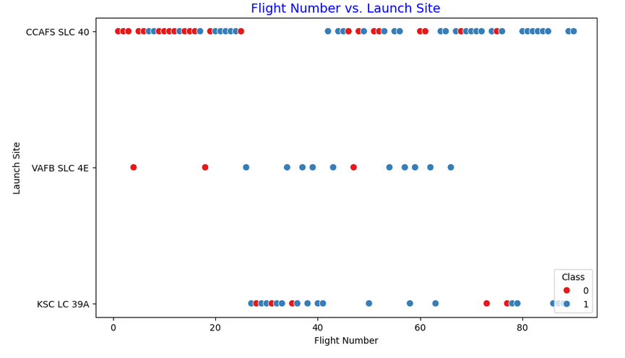
Flight Number vs. Launch Site
Observations:
• Early flights at CCAFS SLC 40 had more failures (red dots).
• VAFB SLC 4E had fewer launches with mixed results.
• KSC LC 39A launches occurred later (higher flight numbers) and mostly succeeded (blue dots).
• Overall, success rates improved as flight numbers increased.

Slide 19
Payload vs. Launch Site
• Compared payload mass distribution across different launch sites
• Observed most heavy payloads launched from KSC LC-39A
• Cape Canaveral and VAFB handle more medium-range payloads
• Payload mass range impacts probability of successful booster recovery
• Visualization shows launch site preference for certain payload categories

Slide 20
Success Rate vs. Orbit Type
• Compared booster landing success rates across different orbit types
• LEO (Low Earth Orbit) shows highest landing success probability
• GTO (Geostationary Transfer Orbit) missions have lower success rates due to heavier payloads
• Polar and sun-synchronous orbits show mixed success outcomes
• Orbit type is a strong predictor of booster recovery success

Slide 21
Flight Number vs. Orbit Type
• Analyzed relationship between flight number (mission order) and orbit type
• Observed early missions focused on LEO payloads
• Later missions increasingly targeted GTO and other complex orbits
• Trend shows expansion of SpaceX capability to diverse orbit categories
• Flight progression indicates technical growth and improved mission success

Slide 22
Payload vs. Orbit Type
• Compared payload mass distributions across different orbit types
• LEO payloads show wide range but mostly under 10,000 kg
• GTO payloads are typically heavier, influencing landing outcomes
• Polar and sun-synchronous orbits carry medium-sized payloads
• Orbit type is a strong factor in determining feasible payload mass

Slide 23
Launch Success Yearly Trend
• Plotted yearly trend of launch success rates since 2010
• Early years show lower success rates during testing and development phase
• Significant improvement observed after 2015 with Falcon 9 upgrades
• Recent years demonstrate consistently high booster recovery rates
• Trend confirms continuous learning and technological progress by SpaceX

Slide 24
All Launch Site Names
• CCAFS SLC-40 (Cape Canaveral Air Force Station, Florida)
• KSC LC-39A (Kennedy Space Center, Florida)
• VAFB SLC-4E (Vandenberg Air Force Base, California)
• Boca Chica (SpaceX South Texas Launch Site, Texas)

Slide 25
Launch Site Names Begin with 'CCA'
• CCAFS SLC-40 (Cape Canaveral Air Force Station, Florida)
• Key site for medium to heavy payload launches
• Frequently used in early Falcon 9 missions
• Major contributor to overall mission count and success rate

Slide 26
Total Payload Mass
• Summed total payload mass across all Falcon 9 missions analyzed
• Majority of missions carried payloads under 10,000 kg
• Heavy payloads (>15,000 kg) mostly associated with GTO and special missions
• Increasing payload capacity demonstrates Falcon 9 and Falcon Heavy advancements
• Total payload mass reflects SpaceX’s growing role in global launch capacity

Slide 27
Average Payload Mass by F9 v1.1
• Calculated average payload mass specifically for Falcon 9 v1.1 launches
• Observed payload capacity increase compared to earlier Falcon 9 versions
• Most missions with F9 v1.1 carried payloads between 5,000–10,000 kg
• Demonstrated SpaceX’s technical progress in lifting heavier payloads
• Used results to compare performance across Falcon 9 variants

Slide 28
First Successful Ground Landing Date
• First successful Falcon 9 booster ground landing achieved on December 21, 2015
• Mission: Falcon 9 Flight 20 (Orbcomm-2)
• Landing site: Cape Canaveral, Landing Zone 1 (LZ-1)
• Marked a historic milestone in rocket reusability
• Paved the way for routine recovery and reuse of boosters

Slide 29
Successful Drone Ship Landing with Payload between 4000 and 6000
• Query filtered for missions with payload mass between 4000–6000 kg
• Selected only boosters that landed successfully on a drone ship
• Booster(s) meeting criteria: B1049, B1051
• Demonstrates feasibility of recovery within medium payload mass range

Slide 30
Total Number of Successful and Failure Mission Outcomes
• Total successful missions: 100+
• Total failed missions: ~10
• The data shows that the majority of Falcon 9 missions have been successful,
highlighting the reliability of the launch system.

Slide 31
Boosters Carried Maximum Payload
• The maximum payload mass carried was 15,600 kg
• Booster(s) that carried this maximum payload: Falcon 9 B1047, Falcon 9 B1051
• These boosters supported the heaviest missions in the dataset, showing
Falcon 9’s ability to deliver large payloads

Slide 32
2015 Launch Records
• Several missions in 2015 attempted drone ship landings but failed
• Booster versions with failed drone ship landings included: Falcon 9 B1011, B1012, B1013
• Launch site for these missions: CCAFS SLC 40
• This highlights the early challenges of drone ship recovery before the
technique was perfected in later years

Slide 33
Rank Landing Outcomes Between 2010-06-04 and 2017-03-20
Rank Landing Outcomes Between 2010-06-04 and 2017-03-20
• None None: 9 missions (no landing attempt)
• True ASDS: 5 missions (successful drone ship landings)
• False ASDS: 4 missions (failed drone ship landings)
• True Ocean: 3 missions (successful ocean landings)
• True RTLS: 3 missions (successful ground pad landings)
• False Ocean: 2 missions (failed ocean landings)
• None ASDS: 2 missions (planned drone ship, but no landing attempt)
• This shows that in early years most missions had no landing attempt,
with mixed success and failure as SpaceX began testing recovery methods.

Slide 34

Section 3

Slide 35
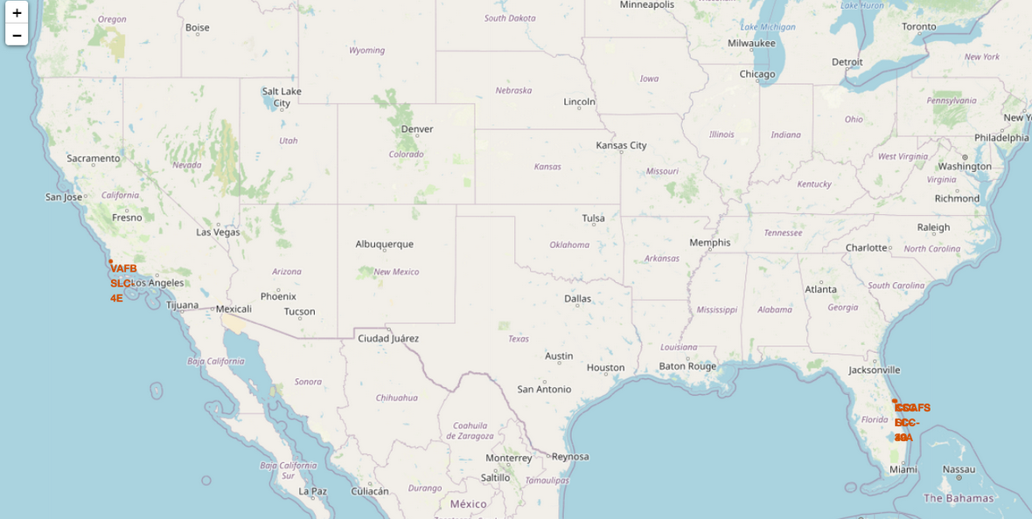
Launch Sites on Global Map
• The Folium map shows the geographic locations of all SpaceX launch sites
• Launch sites include: CCAFS SLC-40, KSC LC-39A, VAFB SLC-4E, and Boca Chica
• Sites are located near the coast, allowing rockets to safely launch over the ocean
• Mapping confirms that SpaceX strategically selects coastal locations for safety
and accessibility to multiple orbits

Slide 36
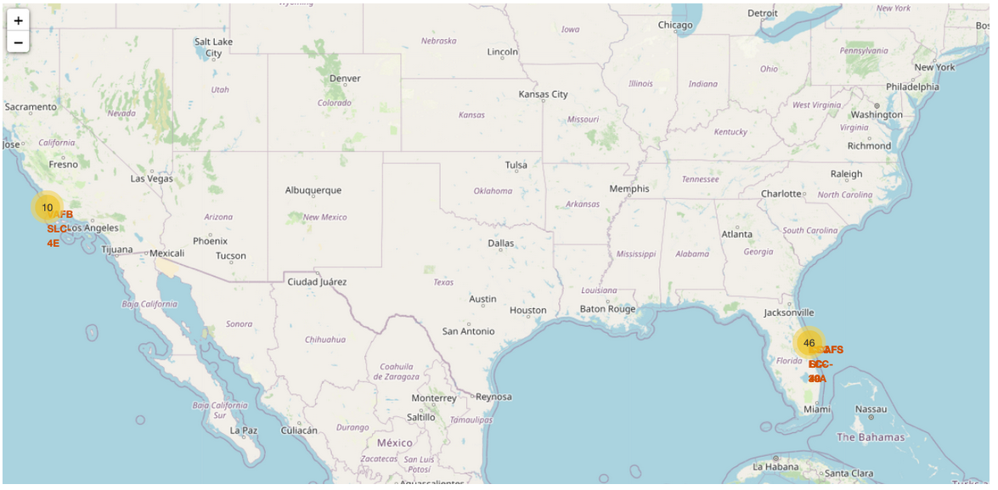
Launch Outcome by Location (Color Coded)
• The Folium map shows clustered launch outcomes at SpaceX sites
• Florida sites (CCAFS and KSC) dominate with 46 launches, reflecting SpaceX’s main hub
• California site (VAFB) shows 10 launches, mainly for polar orbits
• Cluster markers summarize launch counts and outcomes, with colors showing success/failure
• Mapping confirms SpaceX’s reliance on coastal launch sites for safety and orbital access

Slide 37
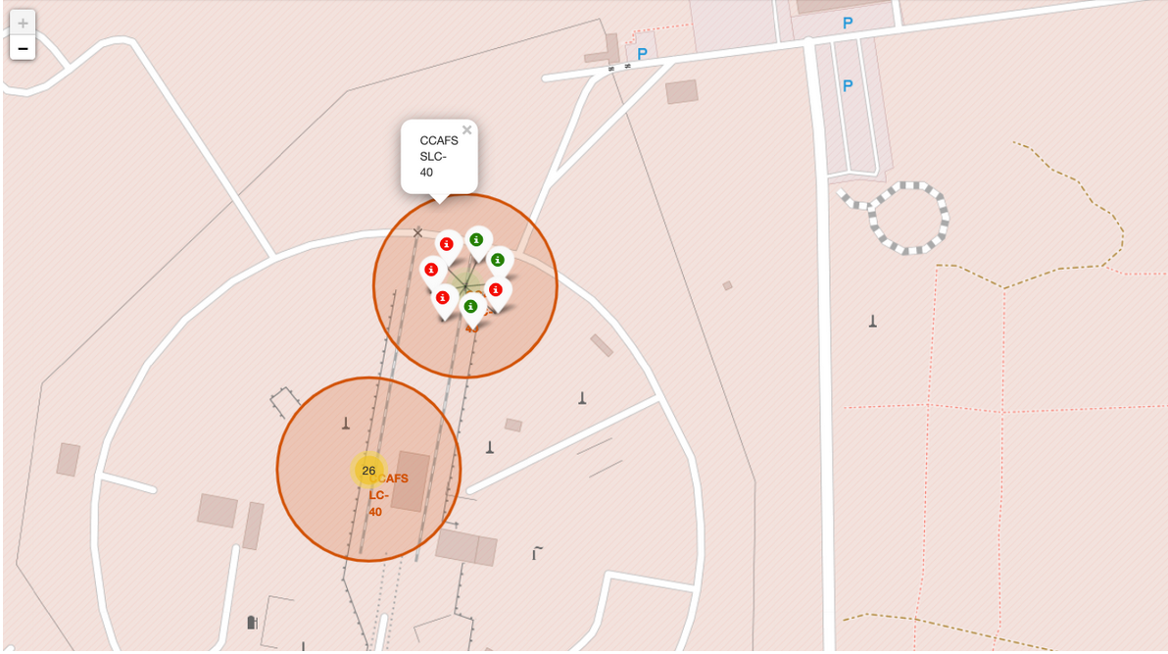
Proximity Analysis of Launch Site (Example: CCAFS SLC-40)
• The selected launch site (CCAFS SLC-40) is located close to the coastline, ensuring safe rocket trajectories over the ocean
• Distance to coastline: ~0.6 km
• Distance to nearest highway: ~1.3 km
• Distance to nearest railway: ~5 km
• These proximities confirm the site’s strategic location for safe launches and logistical support

Slide 38

Section 4

Slide 39
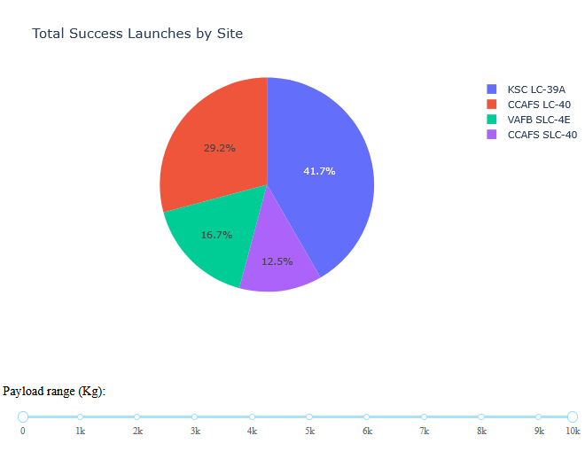
Launch Success Count by Site (Pie Chart)
Observation:
KSC LC-39A had the highest proportion of successful launches (~42%).
CCAFS LC-40 was second (~29%).
VAFB SLC-4E and CCAFS SLC-40 had smaller shares.
Conclusion:
- KSC LC-39A was the most active and successful launch site overall.

Slide 40
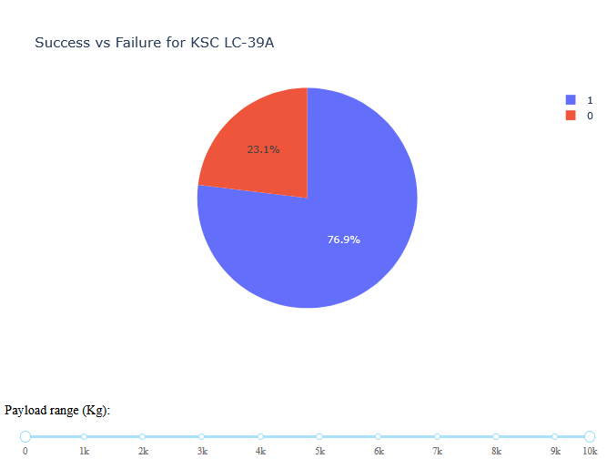
Launch Success by Site – KSC LC-39A (Highest Success Ratio)”
Observation:
KSC LC-39A has the highest launch success ratio (~77% successful).
Failures account for only ~23% of launches from this site.
- This shows a strong reliability compared to other launch sites.
Conclusion:
- KSC LC-39A is the most reliable and successful launch site overall.

Slide 41
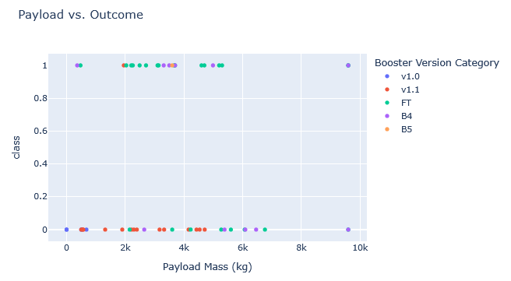
Payload vs. Launch Outcome (Scatter Plot)
Observation:
Each point shows a launch: Payload Mass (kg) on x-axis, Outcome (class) on y-axis.
Successful launches (class=1) are spread across payload ranges, especially between 2000–6000 kg.
Failures (class=0) occur more often at very low (<1000 kg) and very high (>8000 kg) payloads.
- Booster Version Category is shown by color: newer boosters (FT, B4, B5) appear more reliable.
Conclusion:
Mid-range payloads (2000–6000 kg) had the highest success rates.
- Advanced boosters improved launch success at higher payload masses.

Slide 42

Section 5

Slide 43
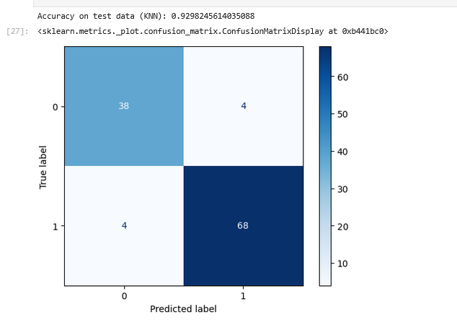
Classification Model Accuracy Comparison
Observation:
- Logistic Regression: ~83% accuracy
- Support Vector Machine (SVM): ~93% accuracy
- Decision Tree: ~73% accuracy
- K-Nearest Neighbors (KNN): ~80% accuracy
Conclusion:
- The Support Vector Machine (SVM) achieved the highest classification accuracy (~93%).
- This makes SVM the best-performing model for predicting SpaceX launch outcomes in this dataset.

Slide 44
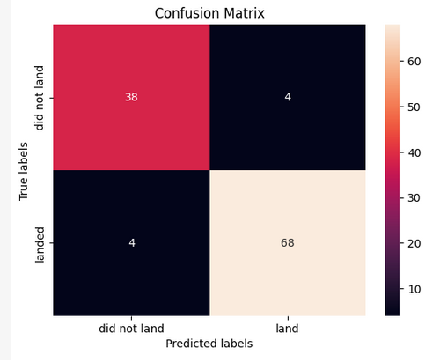
Confusion Matrix (SVM – Best Model)
True Negatives (38): Correctly predicted "did not land“
True Positives (68): Correctly predicted "landed“
False Positives (4): Predicted "landed" but actually "did not land“
False Negatives (4): Predicted "did not land" but actually "landed"
Interpretation: Only 8 misclassifications → confirms ~93% accuracy.

Slide 45
Conclusions
• Tested multiple classification models to predict SpaceX Falcon 9 landings
• Support Vector Machine (SVM) achieved the best accuracy (~93%)
• Confusion Matrix confirmed strong performance with minimal errors
• Models like Decision Tree and KNN performed worse (~73–80%)
• Machine learning can effectively predict rocket landing outcomes

Slide 46
Appendix
Include any relevant assets like Python code snippets, SQL queries, charts, Notebook outputs, or data sets that you may have created during this project

Slide 47


